Slide 1
Eyeball -2
Brain & eyeball

Slide 2
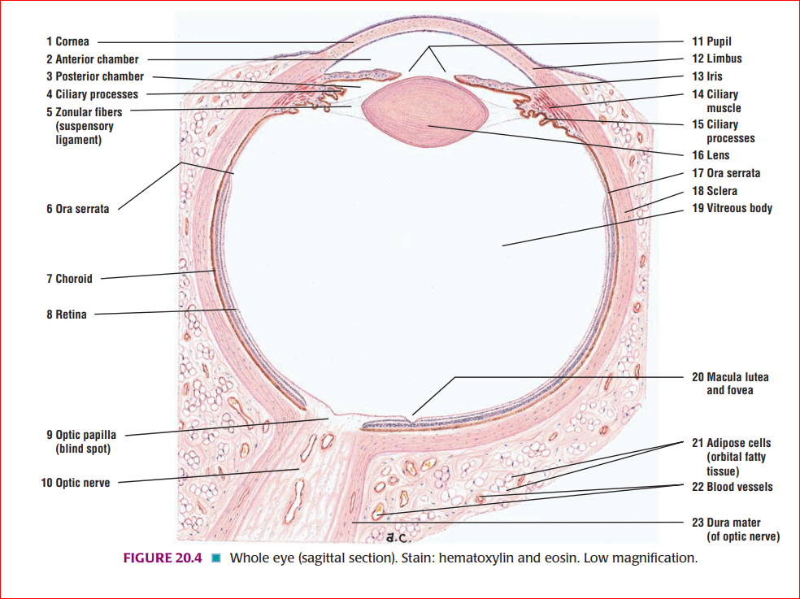
Layers of eyeball

Slide 3
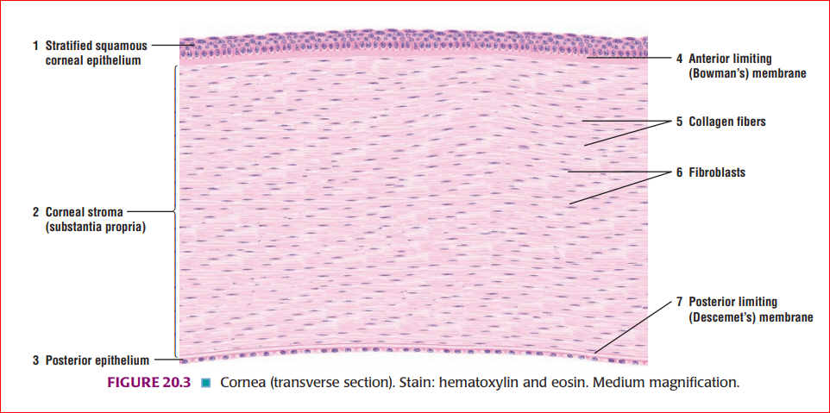
Histological structure of cornea

Slide 4
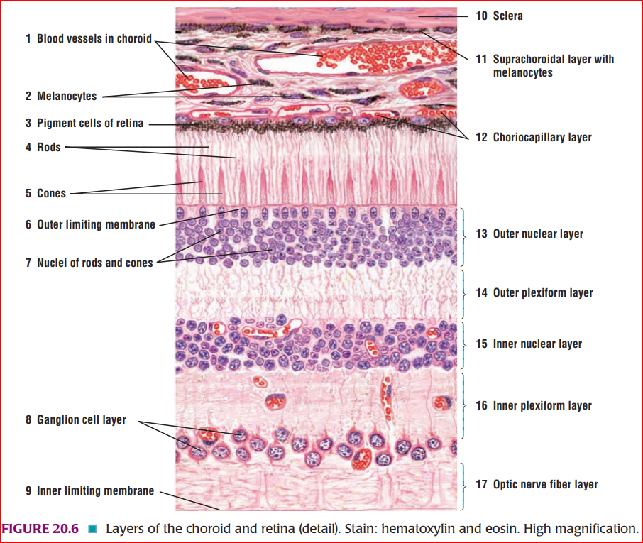
Histological structure of retina

Slide 5
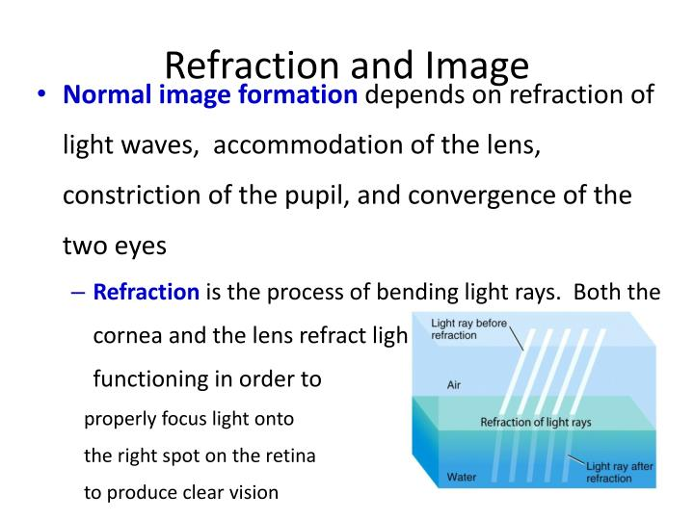

Slide 6
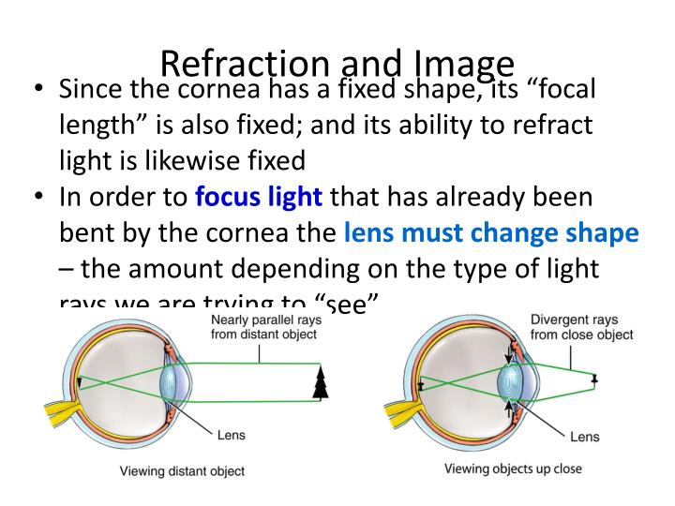

Slide 7
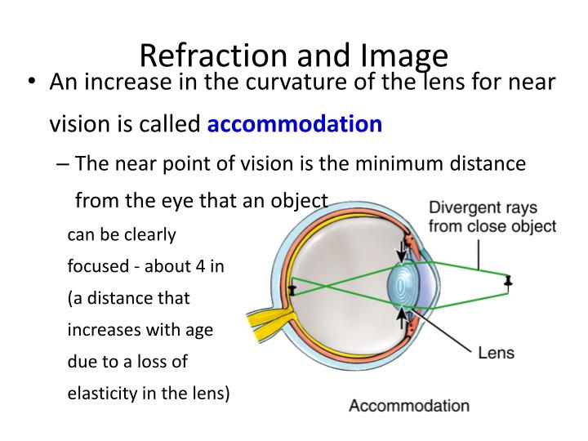

Slide 8
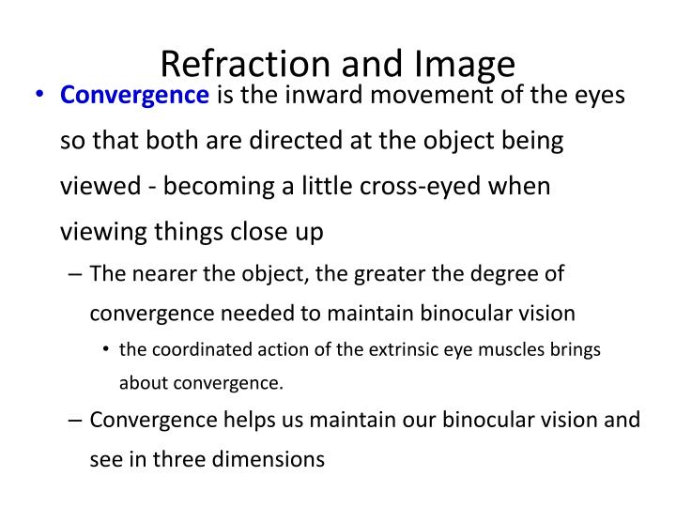

Slide 9
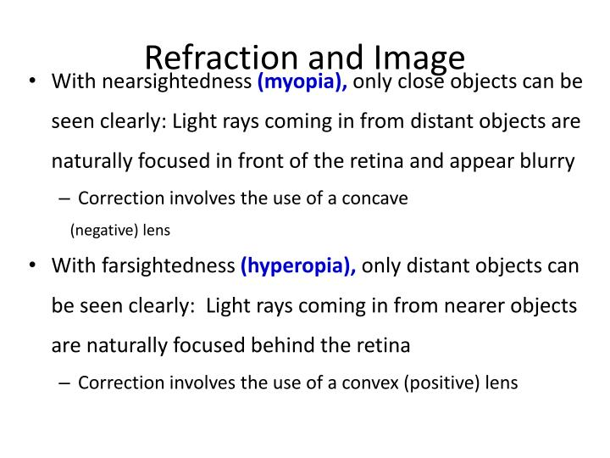

Slide 10
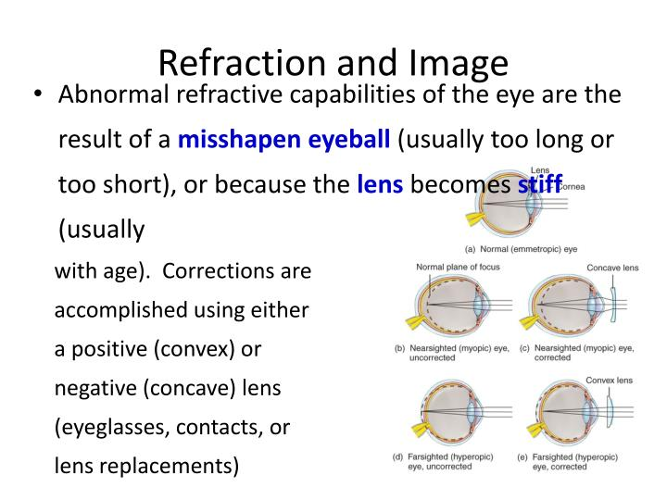

Slide 11
Optic Nerve (Cranial Nerve II)
Origin of the Optic Nerve
The fibers of the optic nerve are the axons of the cells in the ganglionic layer of the retina. They converge on the optic disc and exit from the eye, about 3 or 4 mm to the nasal side of its center, as the optic nerve (Fig. 11-2). The fibers of the optic nerve are myelinated, but the sheaths are formed from oligodendrocytes rather than Schwann cells, since the optic nerve is comparable to a tract within the central nervous system. The optic nerve leaves the orbital cavity through the optic canal and unites with the optic nerve of the opposite side to form the optic chiasma.
Optic Chiasma
The optic chiasma is situated at the junction of the anterior wall and floor of the third ventricle. Its anterolateral angles are continuous with the optic nerves, and the posterolateral angles are continuous with the optic tracts (Fig. 11-2). In the chiasma, the fibers from the nasal (medial) half of each retina, including the nasal half of the macula,1 cross the midline and enter the optic tract of the opposite side, while the fibers from the temporal (lateral) half of each retina, including the temporal half of the macula, pass posteriorly in the optic tract of the same side.

Slide 12
Optic Tract
The optic tract emerges from the optic chiasma and passes posterolaterally around the cerebral peduncle. Most of the fibers now terminate by synapsing with nerve cells in the lateral geniculate body, which is a small projection from the posterior part of the thalamus. A few of the fibers pass to the pretectal nucleus and the superior colliculus of the midbrain and are concerned with light reflexes.
Lateral Geniculate Body The lateral geniculate body is a small, oval swelling projecting from the pulvinar of the thalamus. It consists of six layers of cells, on which synapse the axons of the optic tract. The axons of the nerve cells within the geniculate body leave it to form the optic radiation.
Optic Radiation
The fibers of the optic radiation are the axons of the nerve cells of the lateral geniculate body. The tract passes posteriorly through the retro lenticular part of the internal capsule and terminates in the visual cortex (area 17), which occupies the upper and lower lips of the calcarine sulcus on the medial surface of the cerebral hemisphere. The visual association cortex (areas 18 and 19) is responsible for recognition of objects and perception of color.

Slide 13
Neurons of the Visual Pathway and Binocular Vision
Four neurons conduct visual impulses to the visual cortex: (1) rods and cones, which are specialized receptor neurons in the retina; (2) bipolar neurons, which connect the rods and cones to the ganglion cells; (3) ganglion cells, whose axons pass to the lateral geniculate body; and (4) neurons of the lateral geniculate body, whose axons pass to the cerebral cortex.

Slide 14
Corneal Reflex
Light touching of the cornea or conjunctiva results in blinking of the eyelids. Afferent impulses from the cornea or conjunctiva travel through the ophthalmic division of the trigeminal nerve to the sensory nucleus of the trigeminal nerve. Internuncial neurons connect with the motor nucleus of the facial nerve on both sides through the medial longitudinal fasciculus. The facial nerve and its branches supply the orbicularis oculi muscle, which causes closure of the eyelids.

Slide 15
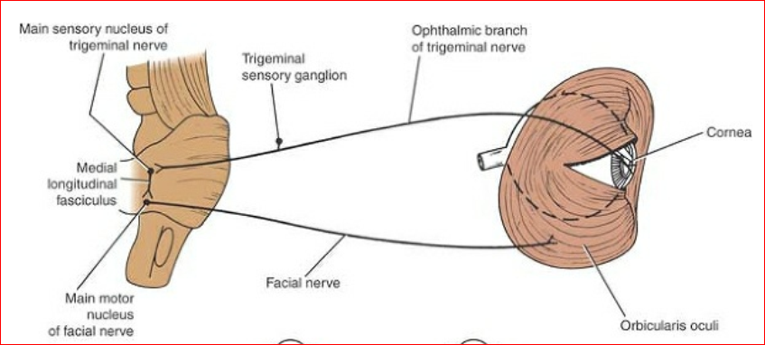
Corneal reflex

Slide 16
Visual Reflexes
Direct and Consensual Light Reflexes
If a light is shone into one eye, the pupils of both eyes normally constrict. The constriction of the pupil on which the light is shone is called the direct light reflex; the constriction of the opposite pupil, even though no light fell on that eye, is called the consensual light reflex. The afferent impulses travel through the optic nerve, optic chiasma, and optic tract. Here, a small number of fibers leave the optic tract and synapse on nerve cells in the pretectal nucleus, which lies close to the superior colliculus. The impulses are passed by axons of the pretectal nerve cells to the parasympathetic nuclei (Edinger-Westphal nuclei) of the third cranial nerve on both sides. Here, the fibers synapse and the parasympathetic nerves travel through the third cranial nerve to the ciliary ganglion in the orbit. Finally, postganglionic parasympathetic fibers pass through the short ciliary nerves to the eyeball and the constrictor pupillae muscle of the iris. Both pupils constrict in the consensual light reflex because the pretectal nucleus sends fibers to the parasympathetic nuclei on both sides of the midbrain. The fibers that cross the median plane do so close to the cerebral aqueduct in the posterior commissure.

Slide 17
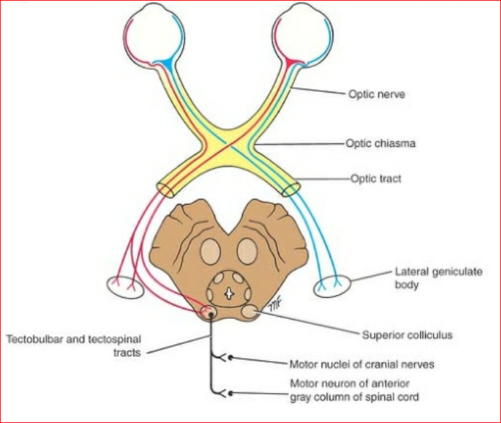
Visual reflex

Slide 18
Accommodation Reflex
When the eyes are directed from a distant to a near object, contraction of the medial recti brings about convergence of the ocular axes; the lens thickens to increase its refractive power by contraction of the ciliary muscle; and the pupils constrict to restrict the light waves to the thickest central part of the lens. The afferent impulses travel through the optic nerve, the optic chiasma, the optic tract, the lateral geniculate body, and the optic radiation to the visual cortex. The visual cortex is connected to the eye field of the frontal cortex. From here, cortical fibers descend through the internal capsule to the oculomotor nuclei in the midbrain. The oculomotor nerve travels to the medial recti muscles. Some of the descending cortical fibers synapse with the parasympathetic nuclei (Edinger-Westphal nuclei) of the third cranial nerve on both sides. Here, the fibers synapse, and the parasympathetic nerves travel through the third cranial nerve to the ciliary ganglion in the orbit. Finally, postganglionic parasympathetic fibers pass through the short ciliary nerves to the ciliary muscle and the constrictor pupillae muscle of the iris.

Slide 19
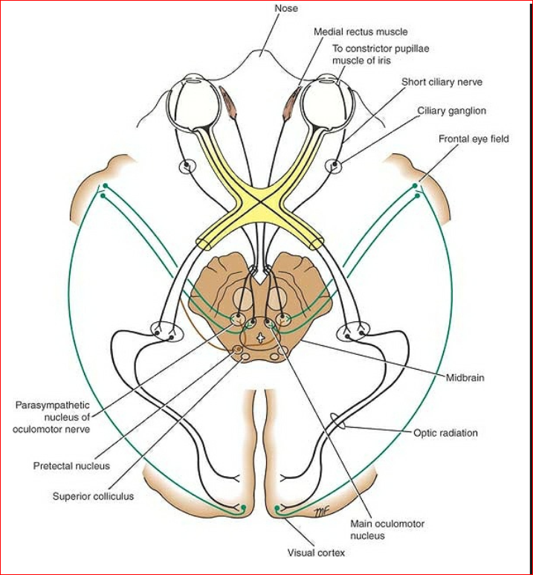
Visual reflexes

Slide 20
Thank you

