Slide 1
REPRODUCTIVE
SYSTEM(MALE)
HISTOLOGICAL STRUCTURE

Slide 2
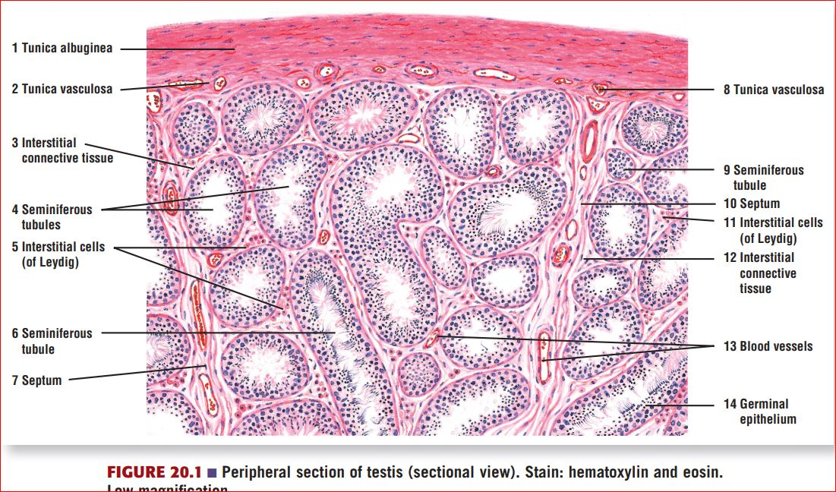
HISTOLOGICAL STRUCTURE OF TESTIS
Each testis is enclosed in a think connective tissue capsule called the tunica albuginea, inner to which is a vascular layer of loose connective tissue called the tunica vasculosa. From this layer connective tissue extend to form interstitial connective tissue, in which interstitial cells of Leydig & vessels are located. Tunica albuginea send septa into the testis from mediastinum testis to divide into lobules. Seminiferous tubules are convoluted tubules present within the lobules, surrounded by interstitial connective tissue & lined by germinal epithelium or complex stratified epithelium.

Slide 3
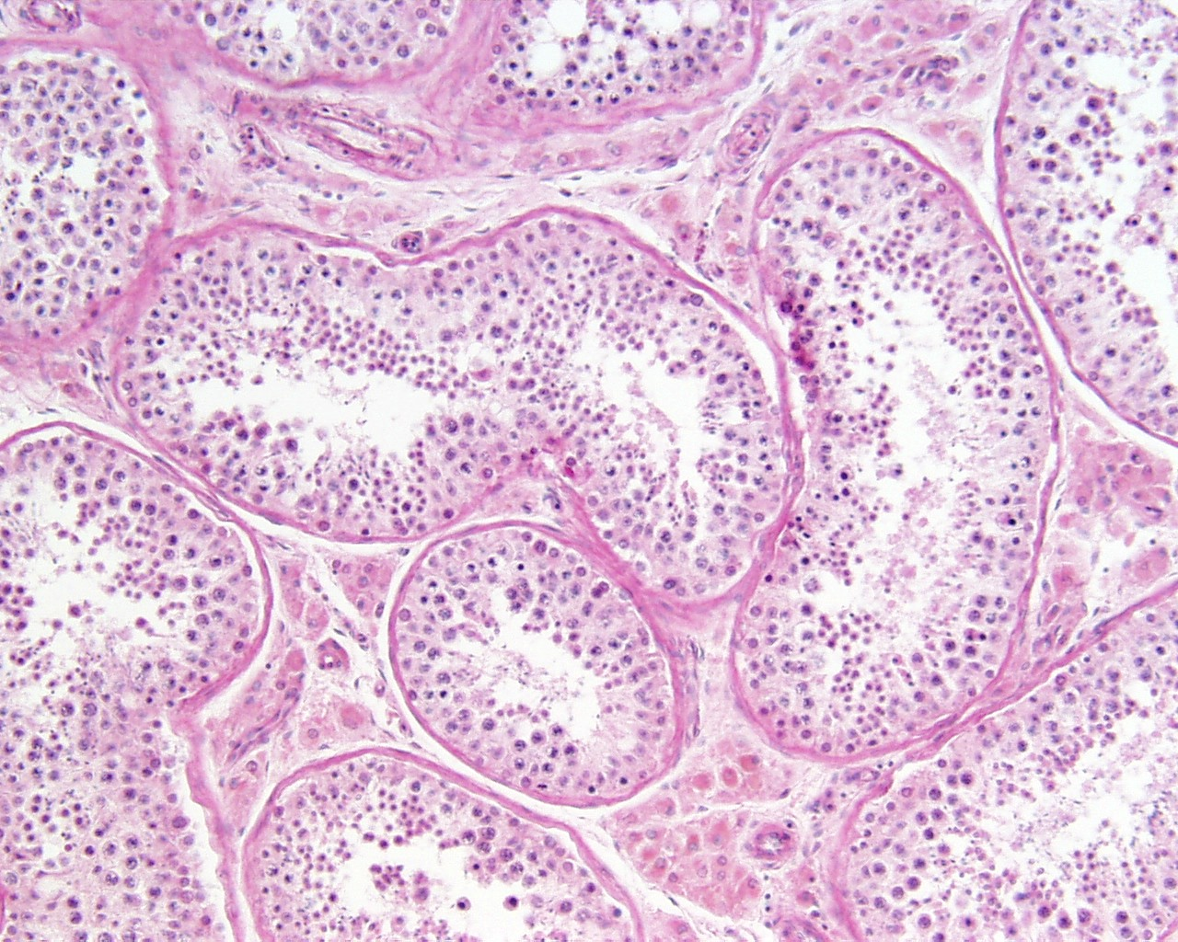
MICROSCOPIC STRUCTURE OF TESTIS
Each seminiferous tubule is lined by complex stratified epithelium.
Complex epithelium means there are multi layered spermatogenic cells & single layer of Sertoli cell.
In between seminiferous tubules interstitial cells of Leydig are present within interstitial connective tissue.

Slide 4
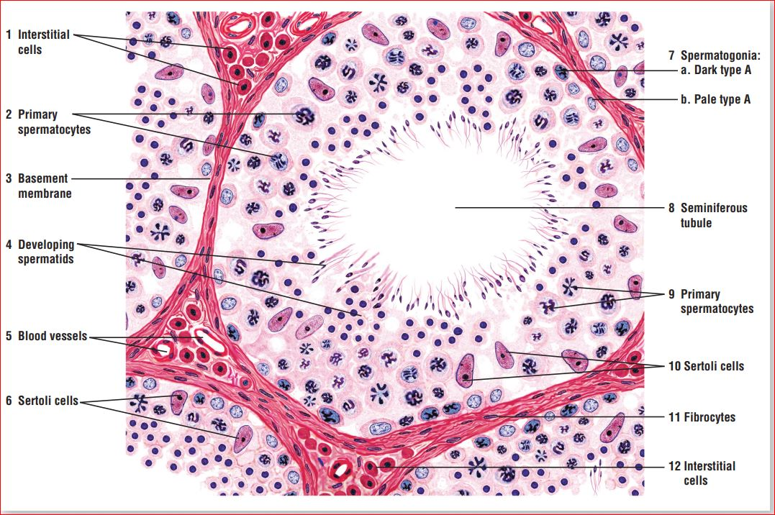
HISTOLOGICAL STRUCTURE OF TESTIS

Slide 5
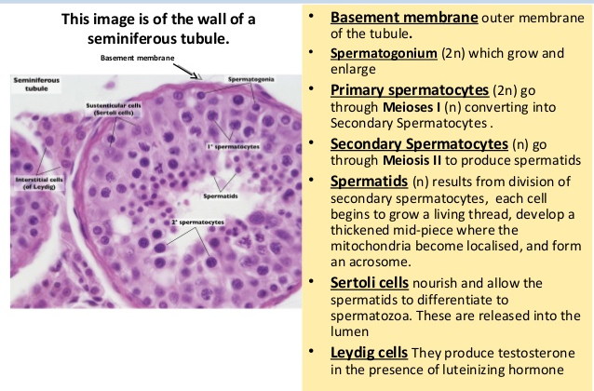
STRUCTURE OF SEMINIFEROUS TUBULE

Slide 6
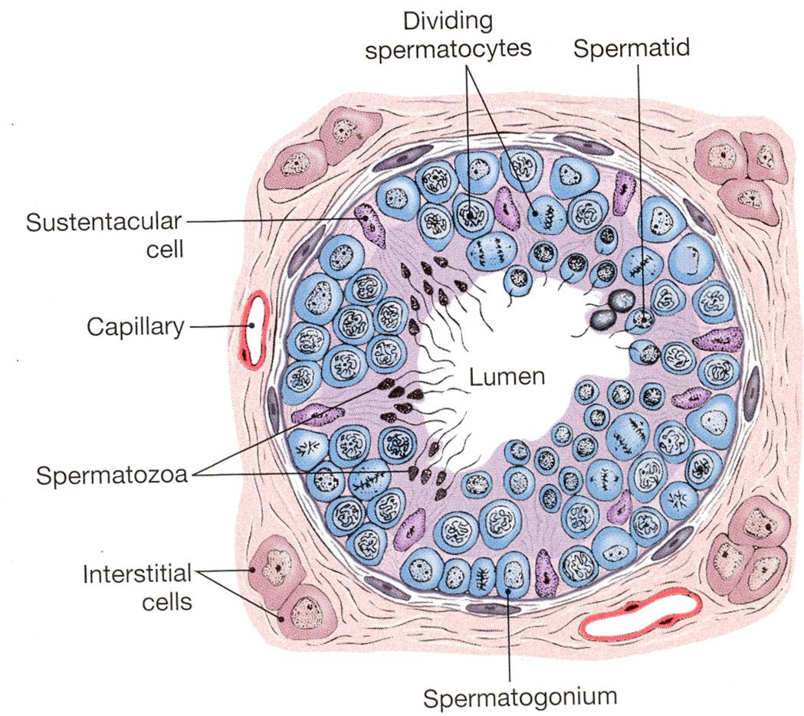
STRUCTURE OF SEMINIFEROUS TUBULE

Slide 7
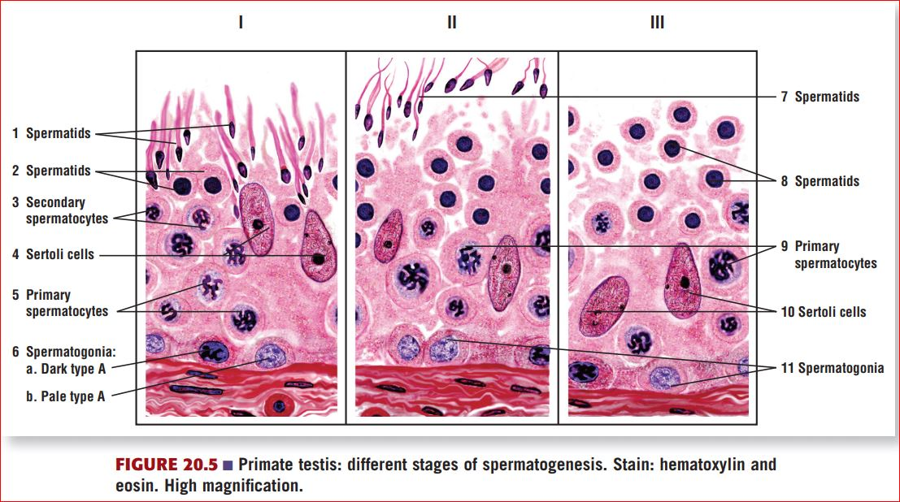
STRUCTURE OFSEMINIFEROUS TUBULE

Slide 8
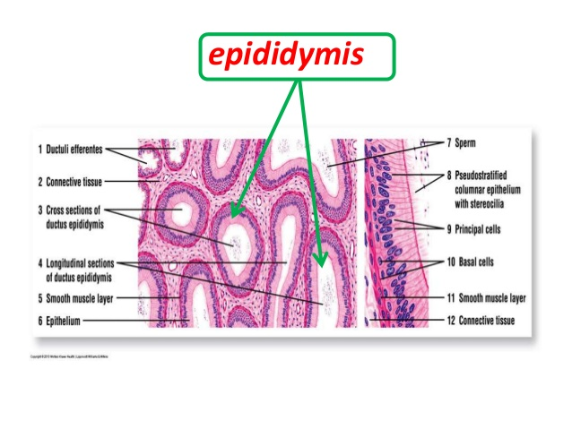
HISTOLOGICAL STRUCTURE OF EPIDIDYMIS
Epididymis is a long, convoluted tubule that is surrounded by connective tissue & a thin smooth muscle layer.
Both cross section & longitudinal section of epididymis shows mature sperm within the lumen of epididymis. The lining pseudostratified columnar epithelium consists of tall columnar principal cells with long nonmotile stereocilia & small basal cells.

Slide 9
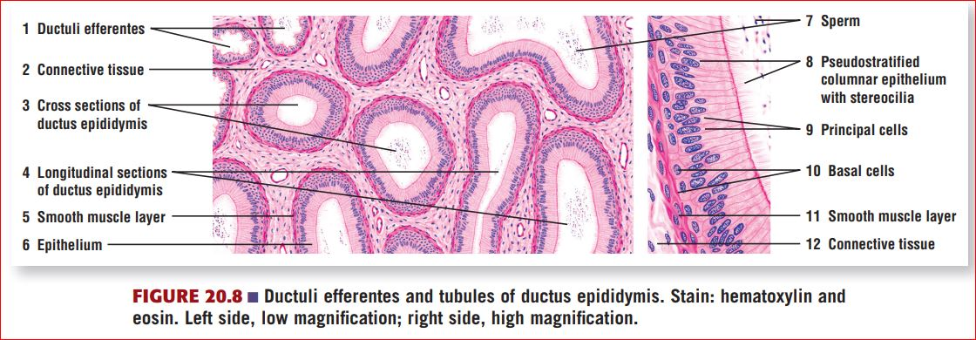
HISTOLOGICAL STRUCTURE OF EPIDIDYMIS

Slide 10
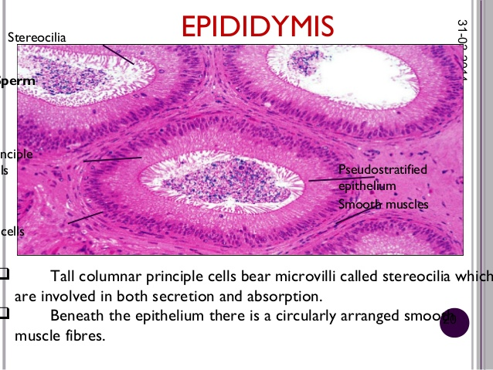
HISTOLOGICAL STRUCTURE OF EPIDIDYMIS

Slide 11
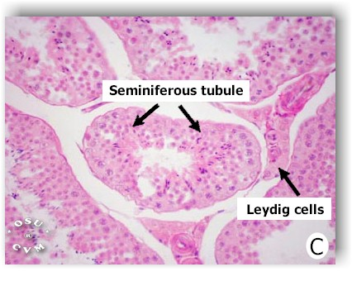
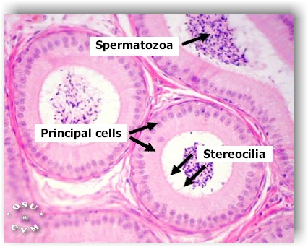
DIFFERENCE BETWEEN THE STRUCTURE OF TESTIS & EPIDIDYMIS

Slide 12
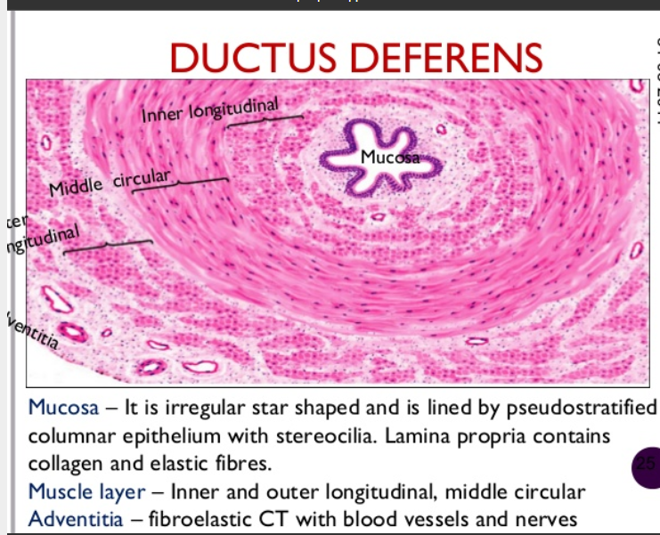
HISTOLOGICAL STRUCTURE OF VAS DEFERENS

Slide 13
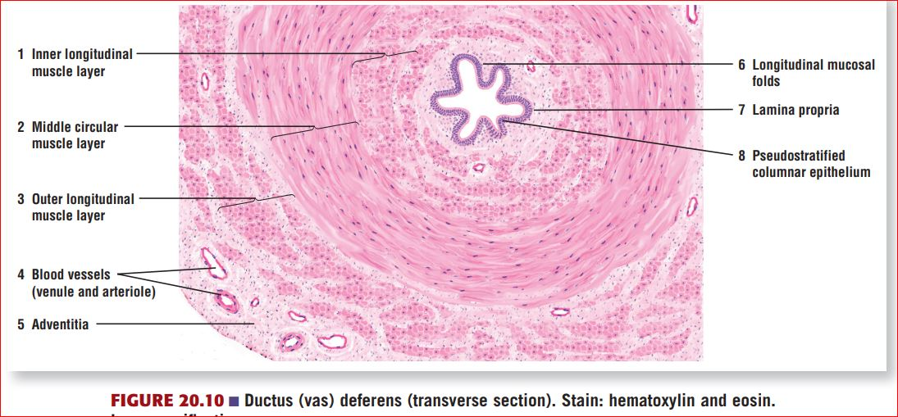
HISTOLOGICAL STRUCTURE OF VAS DEFERENS

Slide 14
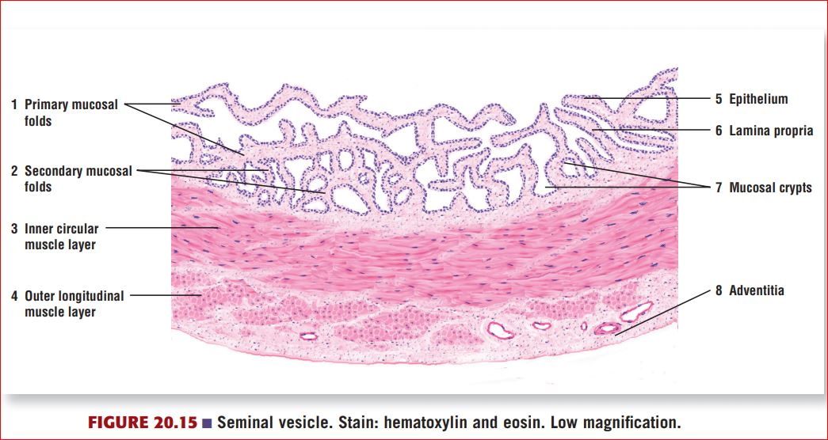
HISTOLOGICAL STRUCTURE OF SEMINAL VESICLE
Lumen of seminiferous tubule shows highly convoluted & irregular mucosal fold into the lumen. These are primary mucosal folds. These folds branched into numerous secondary folds. These folds frequently anastomose to form cavities or mucosal crypts. Lamina propria present within the folds.
Lining epithelium is pseudostratified columnar.
Muscular layer consists of inner circular & outer longitudinal layer of smooth muscle.
Adventitia is the outer most layer consist of connective tissue.

Slide 15
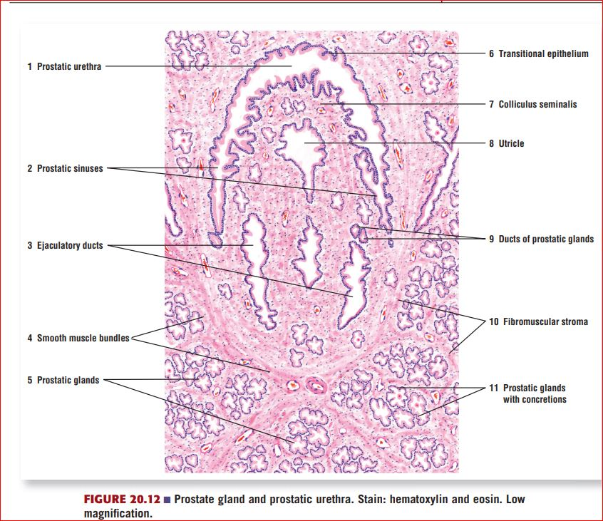
HISTOLOGICAL STRUCTURE OF PROSTATE

Slide 16
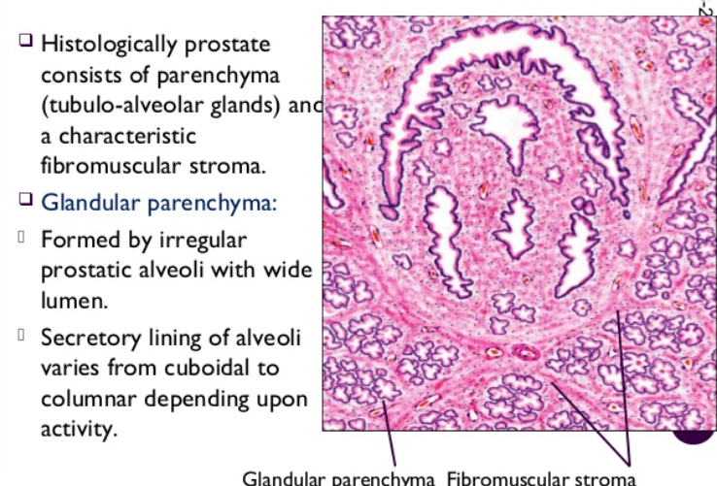
HISTOLOGICAL STRUCTURE OF PROSTATE

Slide 17
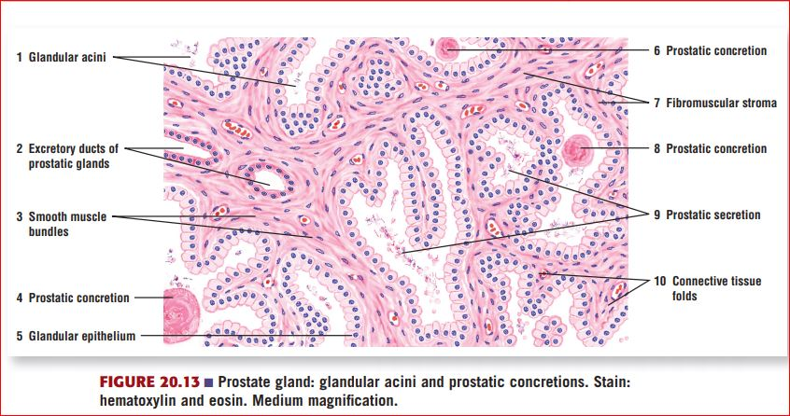
HISTOLOGICAL STRUCTURE OF PROSTATE
Glandular acini in prostate gland is highly variable.
Lining epithelium of prostatic acini is pseudostratified columnar epithelium.
Excretory ducts often resemble glandular acini.
Fibromuscular stroma is another characteristic feature. Smooth muscle & connective tissue blend together in the stroma & distributed throughout the gland.

Slide 18
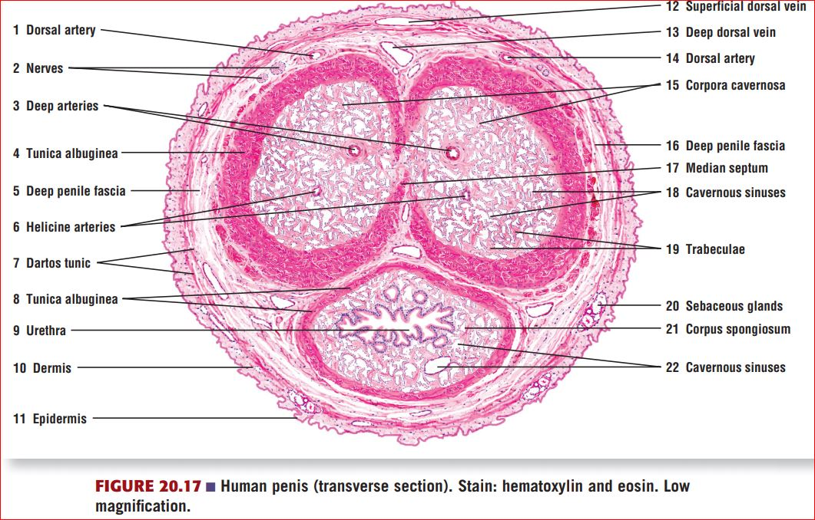
HISTOLOGICAL STRUCTURE OF PENIS
Cross section shows two corpora cavernosum dorsally & one corpora spongiosum ventrally that form the body of the organ.
A thick capsule tunica albuginea cover the corpora cavernosum & forms a median septum between the two bodies.
Thinner tunica albuginea cover the corpora spongiosum.
Urethra passage through the corpora spongiosum.
All three cavernosum surrounded by loose connective tissue called the deep penile fascia.

