Slide 1
BONES
&
JOINTS
OF
ABDOMEN

Slide 2
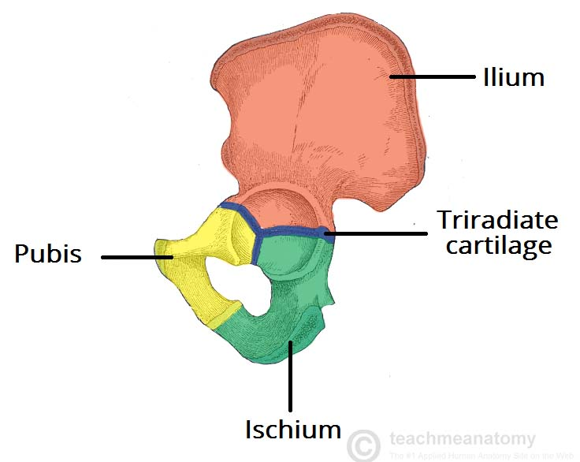
HIP BONE
Anatomical points :
Anterior superior iliac spine & pubic tubercle lies in the same coronal plane.
Ischial spine & the pubic crest lies in the same horizontal plane.
Iliac crest is directed upward.
Acetabulum directed laterally.
Type – Irregular bone.
It has 3 parts – ilium, ischium & pubis. They are connected by “Y” shaped hyaline cartilage in the acetabulum during development. Later they fused together.

Slide 3
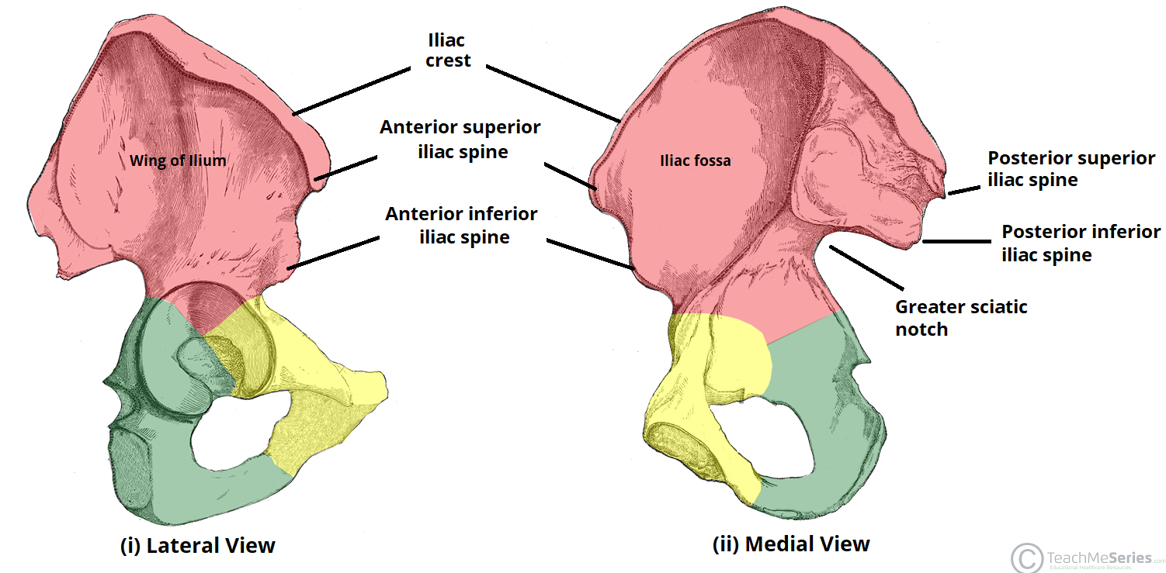
Hip bone

Slide 4
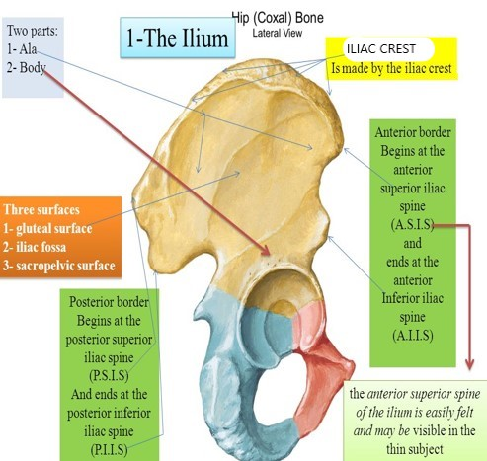
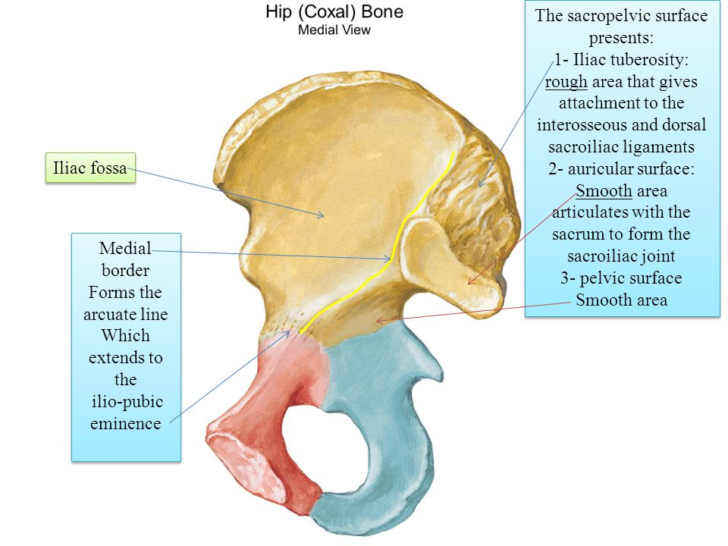
ILIUM of Hip bone

Slide 5
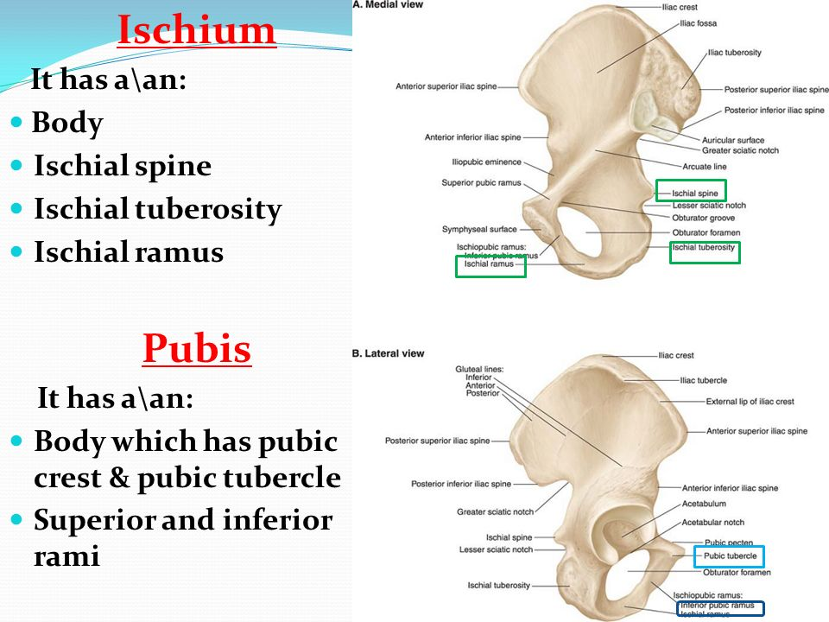
ISCHIUM & PUBIS of Hip bone

Slide 6
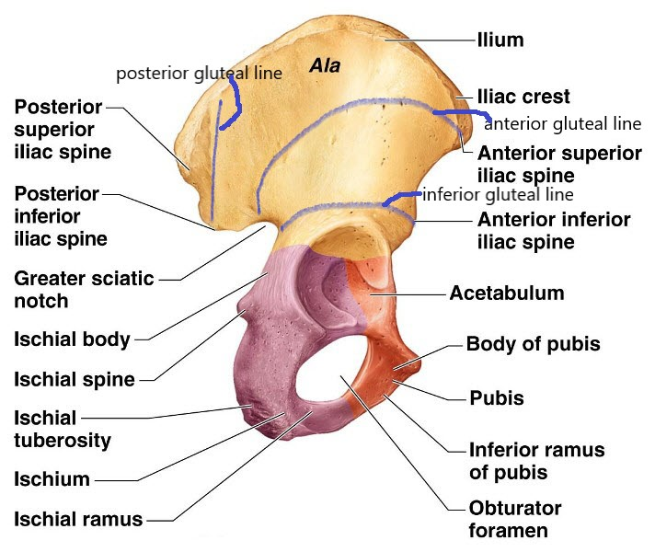
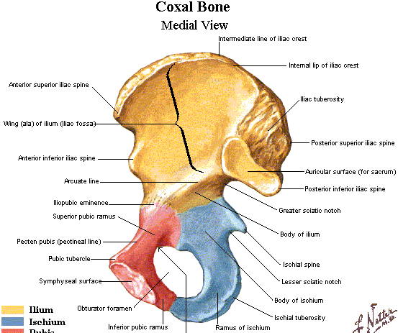
Medial & lateral side of Hip bone

Slide 7
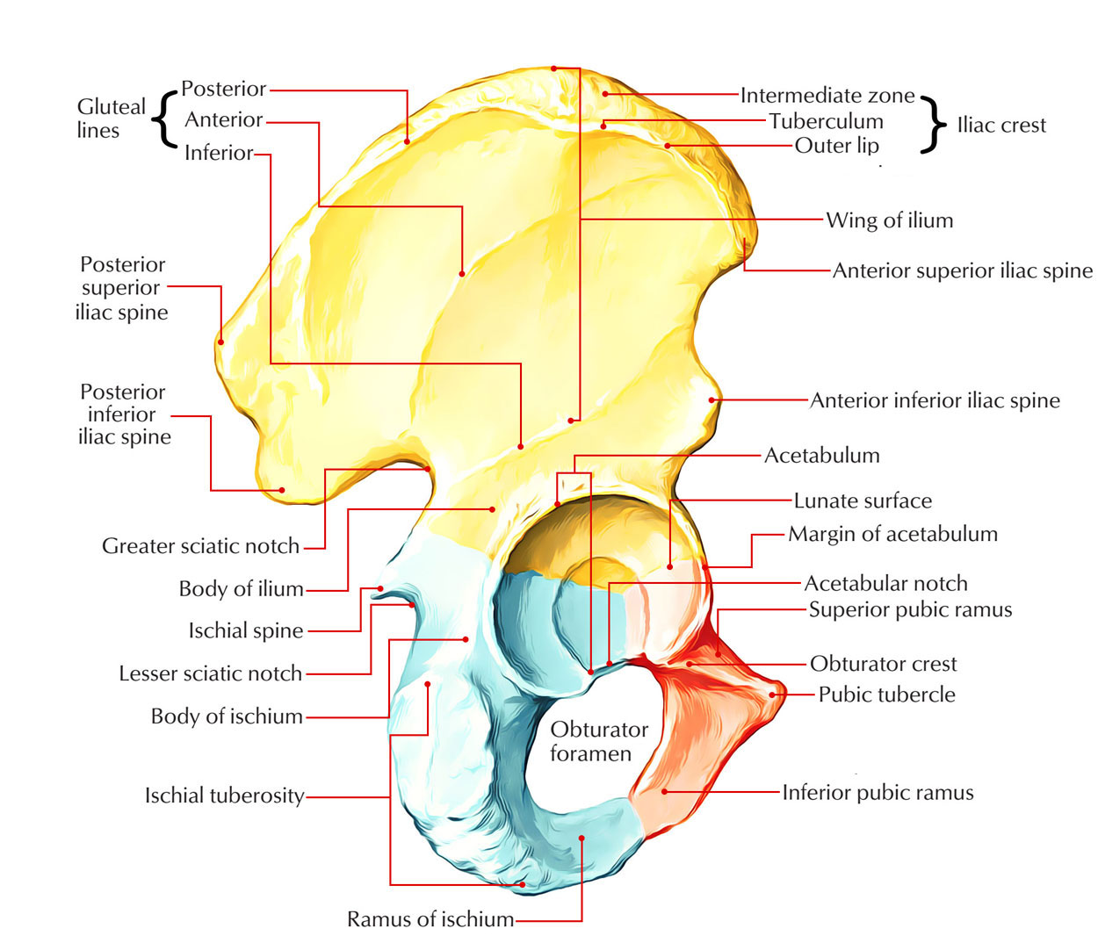
Lateral side of Hip bone

Slide 8
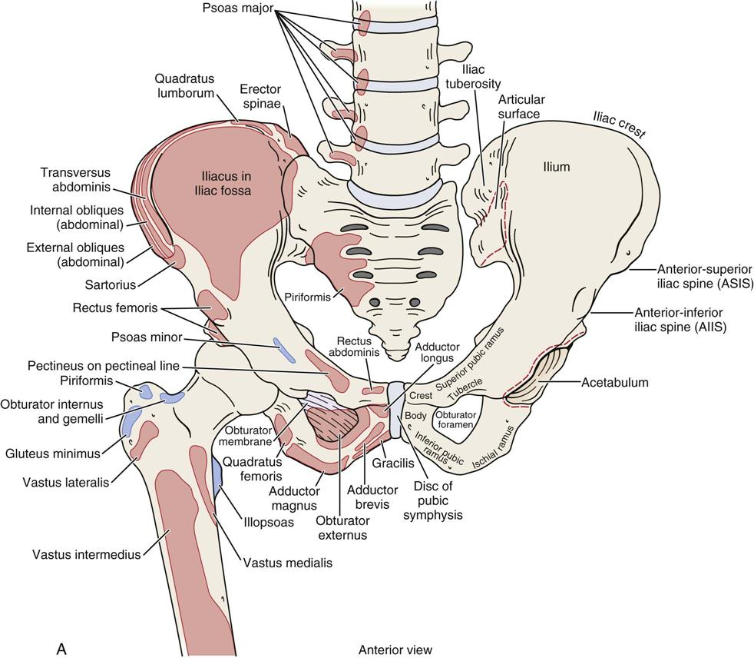
Muscle Attachment of Hip Bone

Slide 9
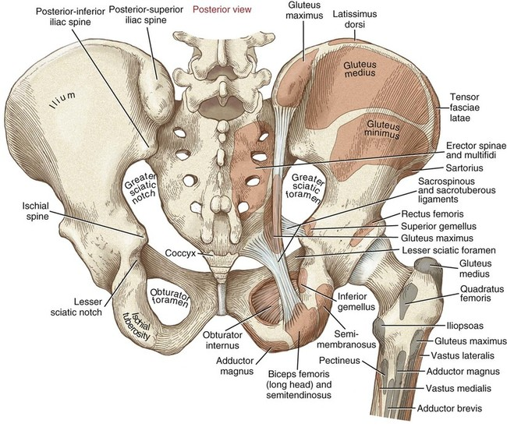
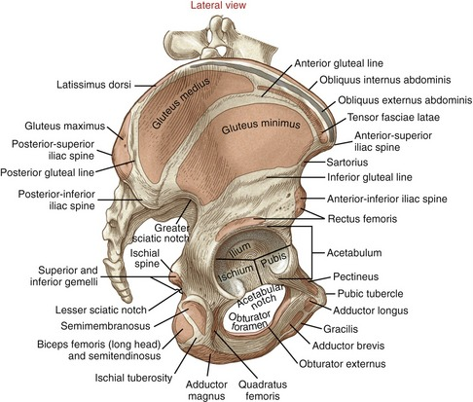
Muscle Attachment of Hip Bone

Slide 10
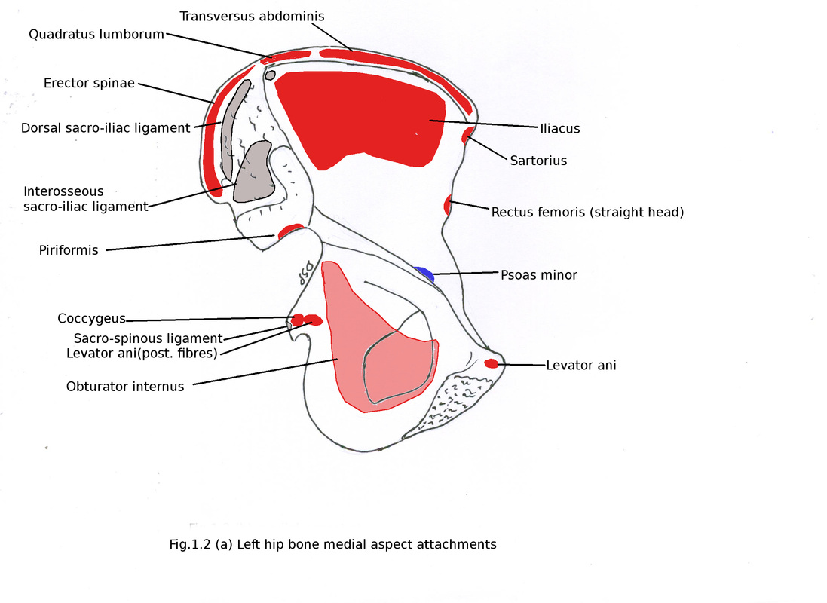
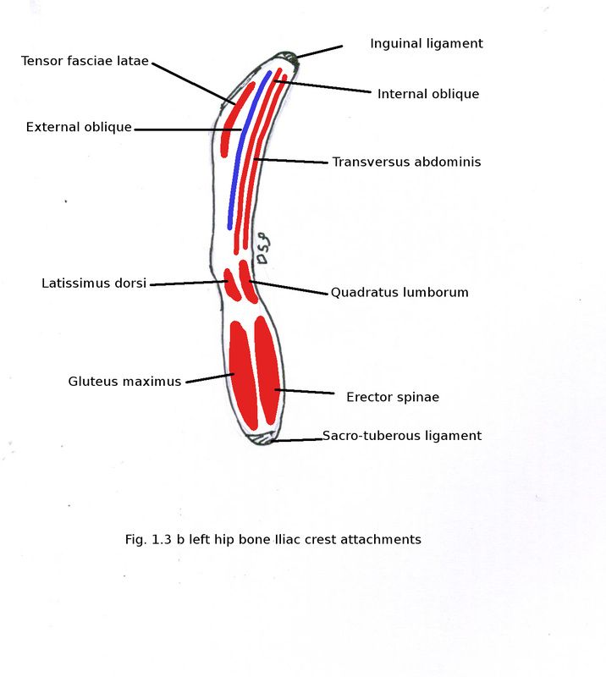
Muscle Attachment of Hip Bone

Slide 11
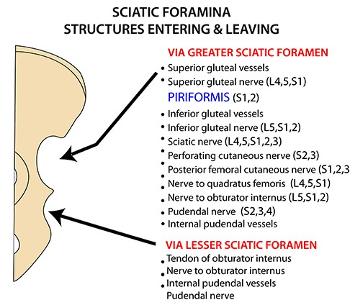
Structures Passes Through The Sciatic Foramina

Slide 12
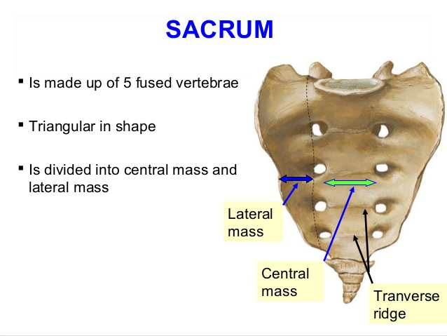
SACRUM

Slide 13
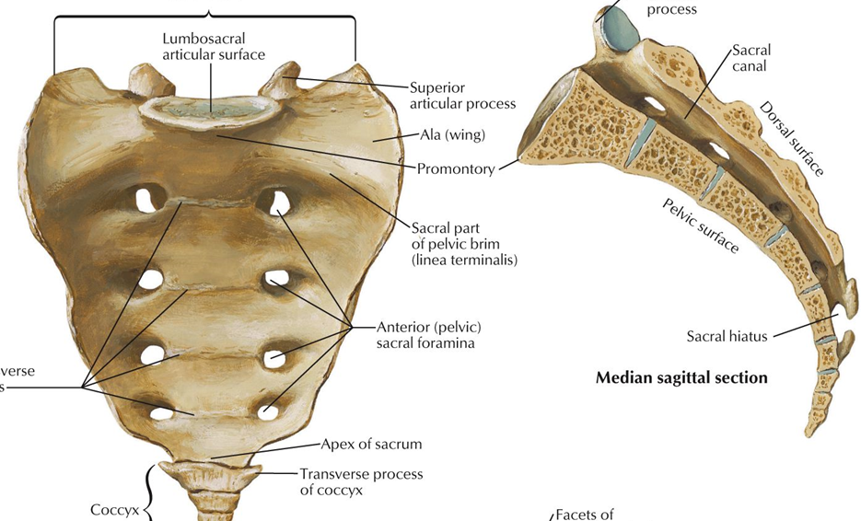
SACRUM
Anatomical points:
Base is directed upward & apex is directed downward.
Sacral promontory projects forward & directed slightly downwards.
Pelvic surface is concave & directed downward & forward.
Dorsal surface is directed backward & upward.
Type – Irregular bone.

Slide 14
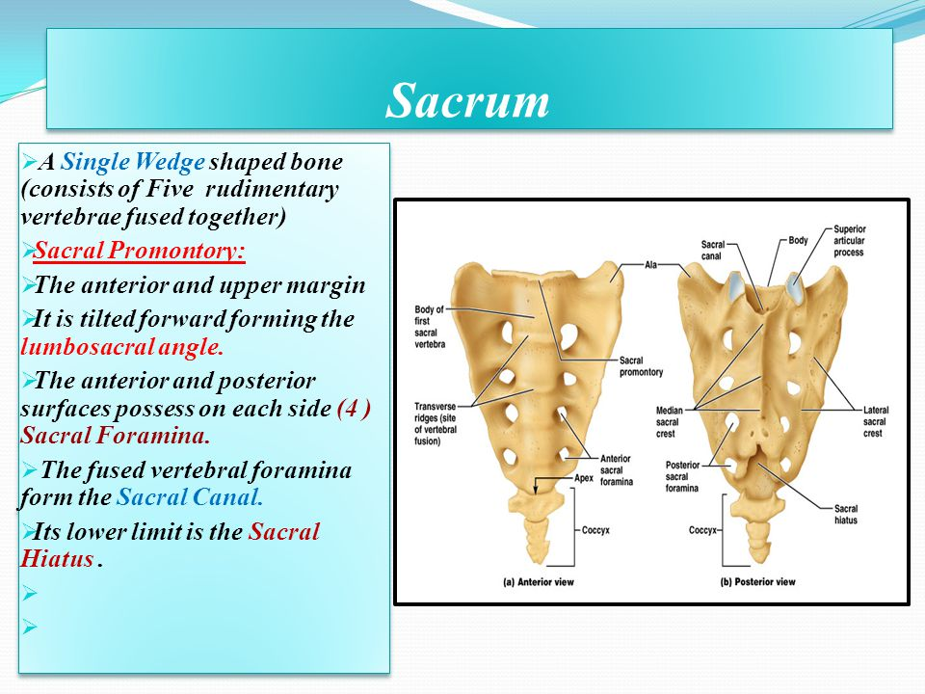
SACRUM

Slide 15
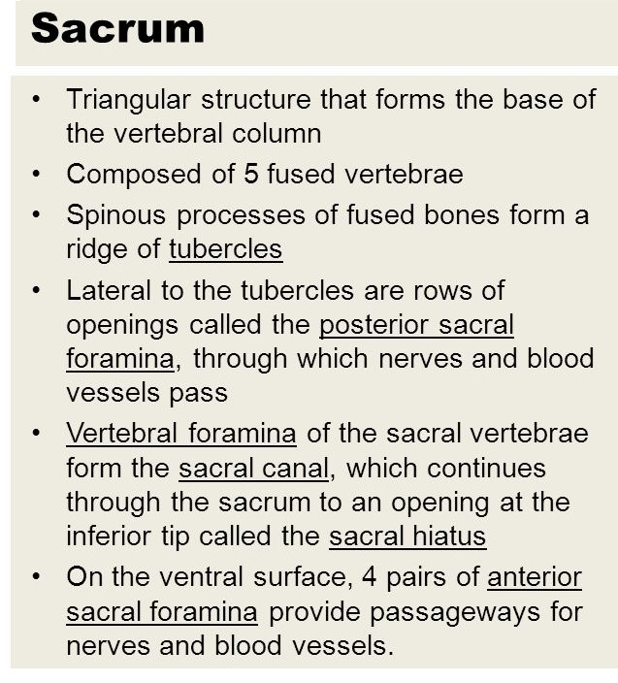
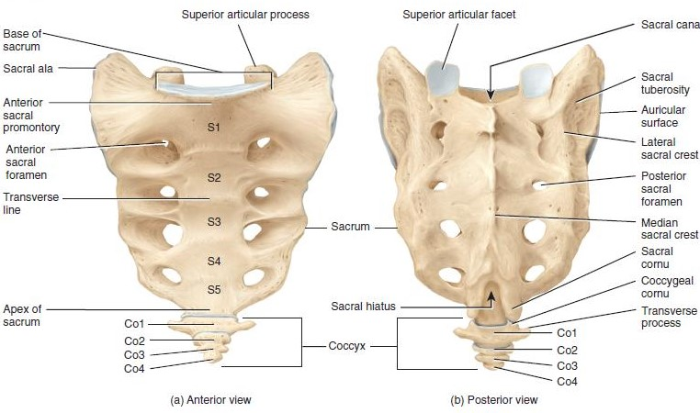
SACRUM

Slide 16
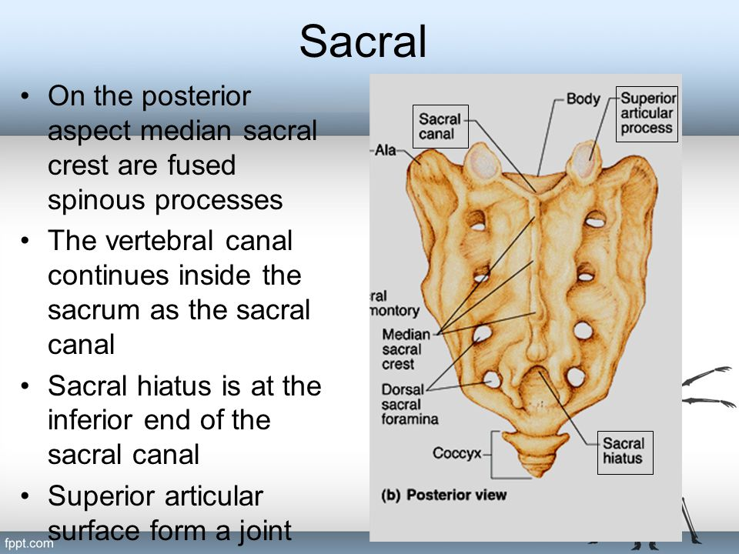
SACRUM

Slide 17
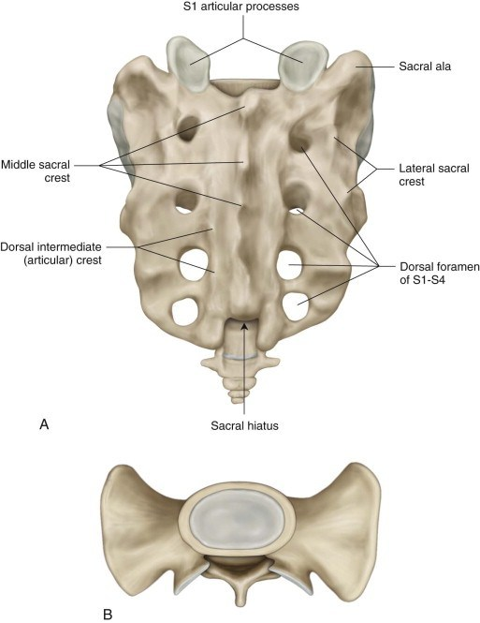
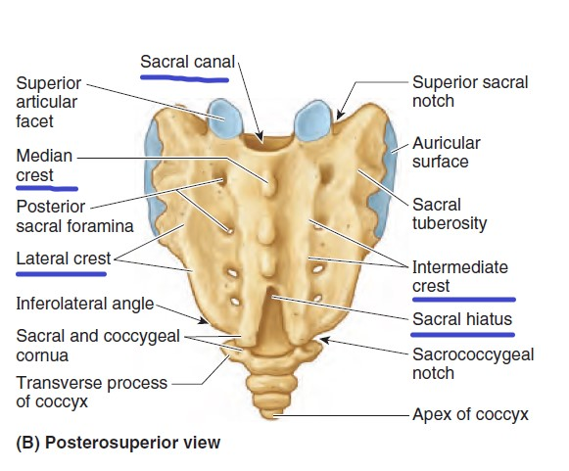
SACRUM
Median sacral crest form by fusion of all spinous processes.
Intermediate sacral crest form by fusion of articular processes.
Lateral sacral crest form by fusion of transverse processes.

Slide 18
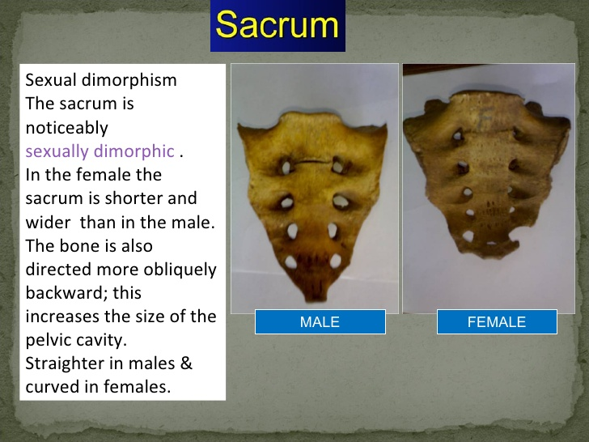
Sex difference of sacrum

Slide 19
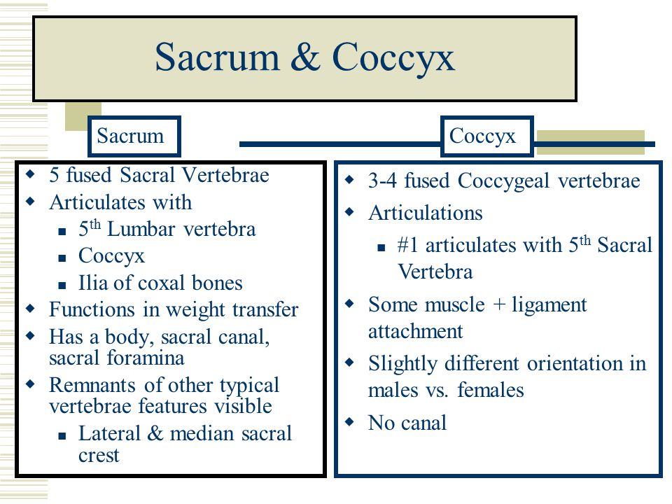
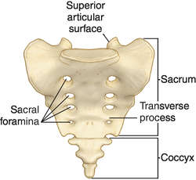
Difference Between Sacrum & Coccyx

Slide 20
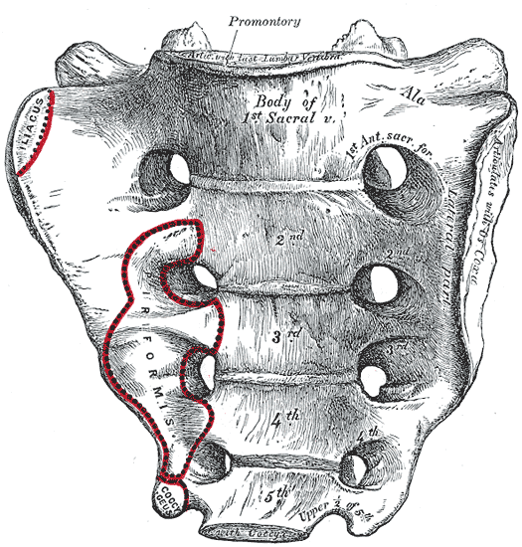
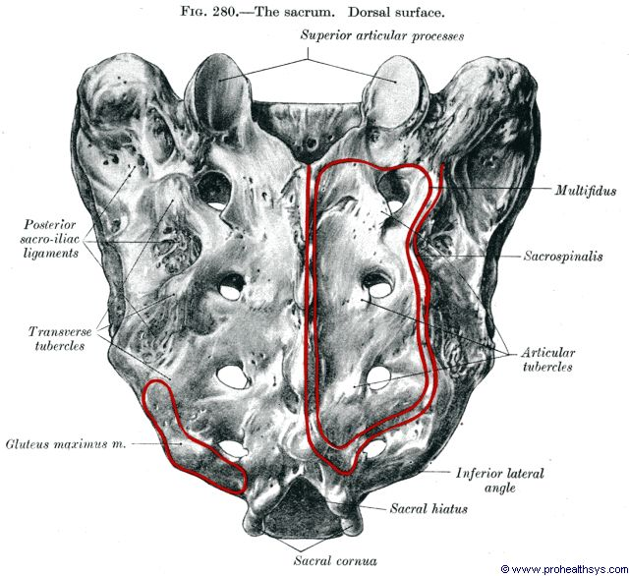
Muscle Attachment of Sacrum

Slide 21
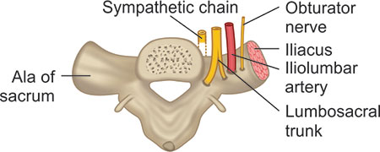
Relation of Ala of the Sacrum
From medial to lateral-:
Sympathetic chain
Lumbosacral trunk
Iliolumbar artery
Obturator nerve

Slide 22
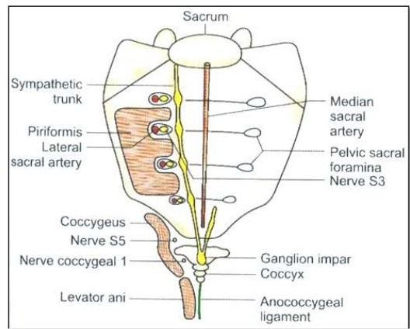
Relation of pelvic surface of Sacrum
Medial to lateral:
Median sacral artery
Sympathetic chain
Ventral rami of sacral spinal nerve
Lateral sacral artery

Slide 23
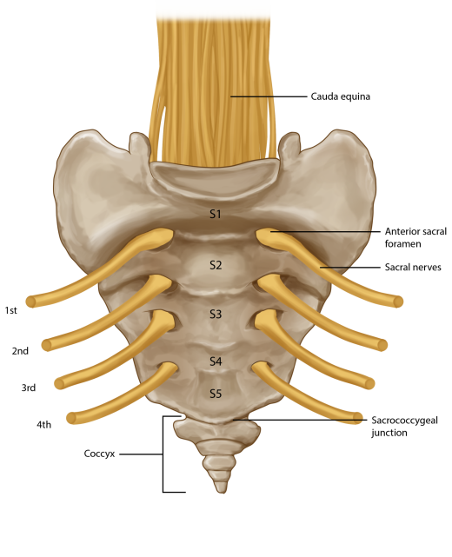
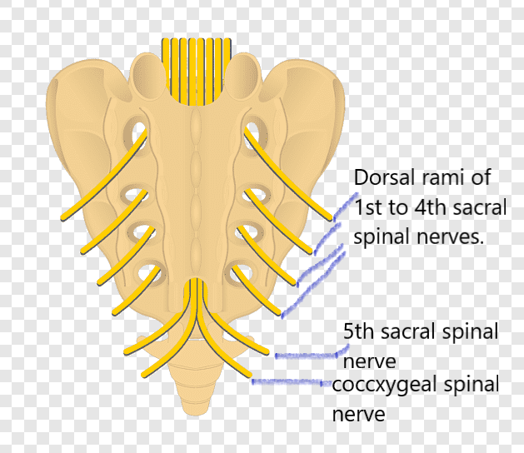
Through the ventral sacral foramina the ventral rami of 1st to 4th sacral spinal nerves passes & through the dorsal sacral foramina the dorsal rami of 1st to 4th sacral spinal nerves passes. 5th sacral spinal nerve & the coccygeal spinal nerve passes through the sacral hiatus.

Slide 24
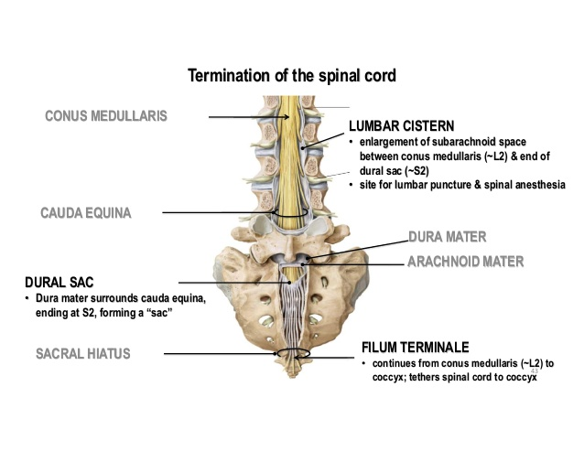
Cauda Equina, Dura mater, Arachnoid mater & Filum terminale passes through the sacral canal.

Slide 25
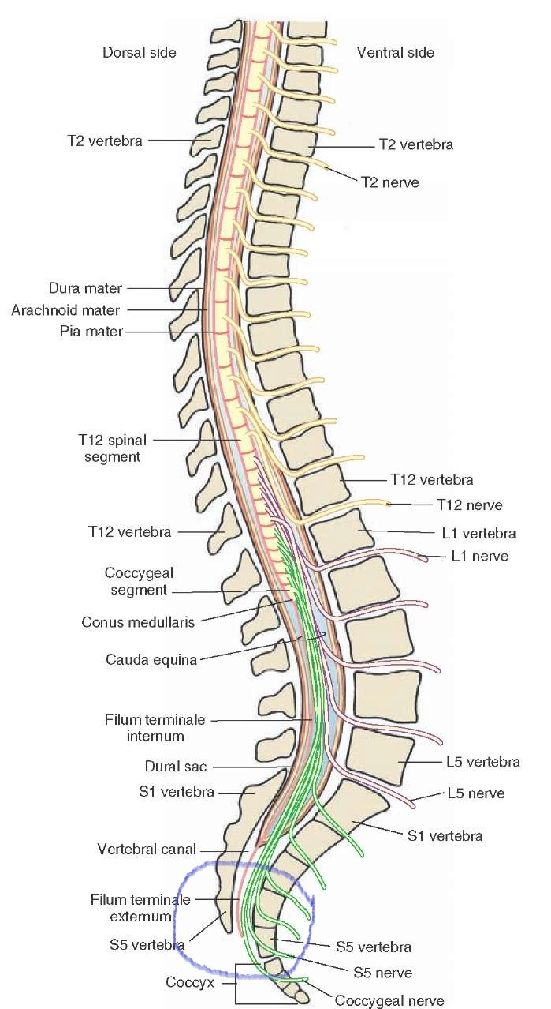
Sacral Hiatus
Blue circle marked as sacral hiatus:
Filum terminale, 5th sacral spinal nerve & coccygeal nerve passes through the sacral hiatus.
*Pink line denoted as filum terminale & green line denoted as spinal nerve.

Slide 26
THANK YOU

